Slide 1
Increasing FPS on Real-Time Fire Segmentation
Michael Marinaccio and Bigyan Ghimire

Slide 2
Target / Goal
From “A Real-Time Fire Segmentation Method Based on a Deep Learning Approach” paper
Goals
Reduce inference time, i.e increase FPS
Maintain comparable Mean Intersection of Union (mIoU)
Mengna Li, Youmin Zhang, Lingxia Mu, Jing Xin, Ziquan Yu, Shangbin Jiao, Han Liu, Guo Xie, Yi Yingmin,
A Real-time Fire Segmentation Method Based on A Deep Learning Approach, IFAC-PapersOnLine,
Volume 55, Issue 6, 2022, Pages 145-150, ISSN 2405-8963, https://doi.org/10.1016/j.ifacol.2022.07.120.
(https://www.sciencedirect.com/science/article/pii/S2405896322005055)

Slide 3
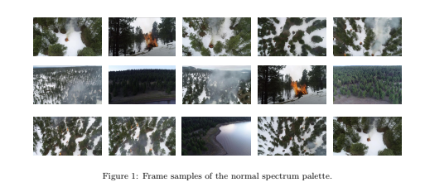
Dataset
FLAME Dataset
Published in 2020, contains 47,992 frames of rural pile burns
Captured with Zenmuse XS4 and DJI Phantom 3 drone cameras
Our focus
2,003 frames, 3480x2160
2,003 ground truth mask frames, 3480x2160

Slide 4

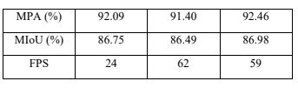
Related Work/SOTA
Paper results -> used deeplabv3+ ->
State of the Art Real-Time Semantic Segmentation Models (on cityscapes):
PP-LiteSeg-T1
mIoU - 72%
FPS - 273.6
STDC1-50
mIoU - 71.9%
FPS - 250.4

Slide 5
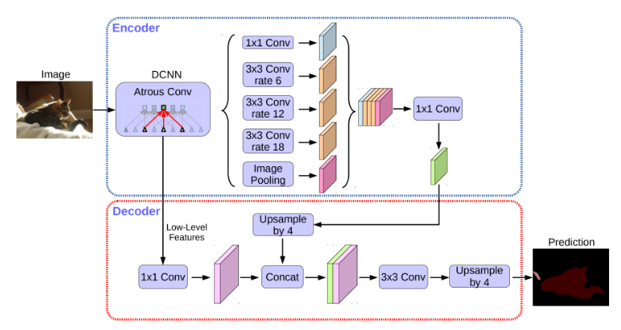
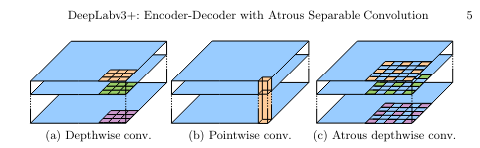
DeepLabv3+ architecture
Chen, L.C., Zhu, Y., Papandreou, G., Schroff, F. and Adam, H., 2018. Encoder-decoder with atrous separable convolution for semantic image segmentation. In Proceedings of the European conference on computer vision (ECCV) (pp. 801-818).
Encoder-Decoder structure
Applies atrous convolution at multiple scales / different sampling rates
Uses depthwise separable convolutions to decrease computational cost

Slide 6
Models We Studied
Deeplabv3+
PSPnet
U-Net
SegNet
Why we choose UNET? The reason being that UNET works best when there is low amount of training data.

Slide 7
Our Approach - Unet
Specialized for semantic segmentation tasks.
Uses encoder-decoder structure for context extraction and precise localization.
Encoder: convolution blocks followed by a maxpool downsampling
Decoder: upsampling and concatenation followed by regular convolution operations
Utilizes skip connections for details preservation.
Underlies many modern image generation models, such as DALL-E, Midjourney, and Stable Diffusion.

Slide 8
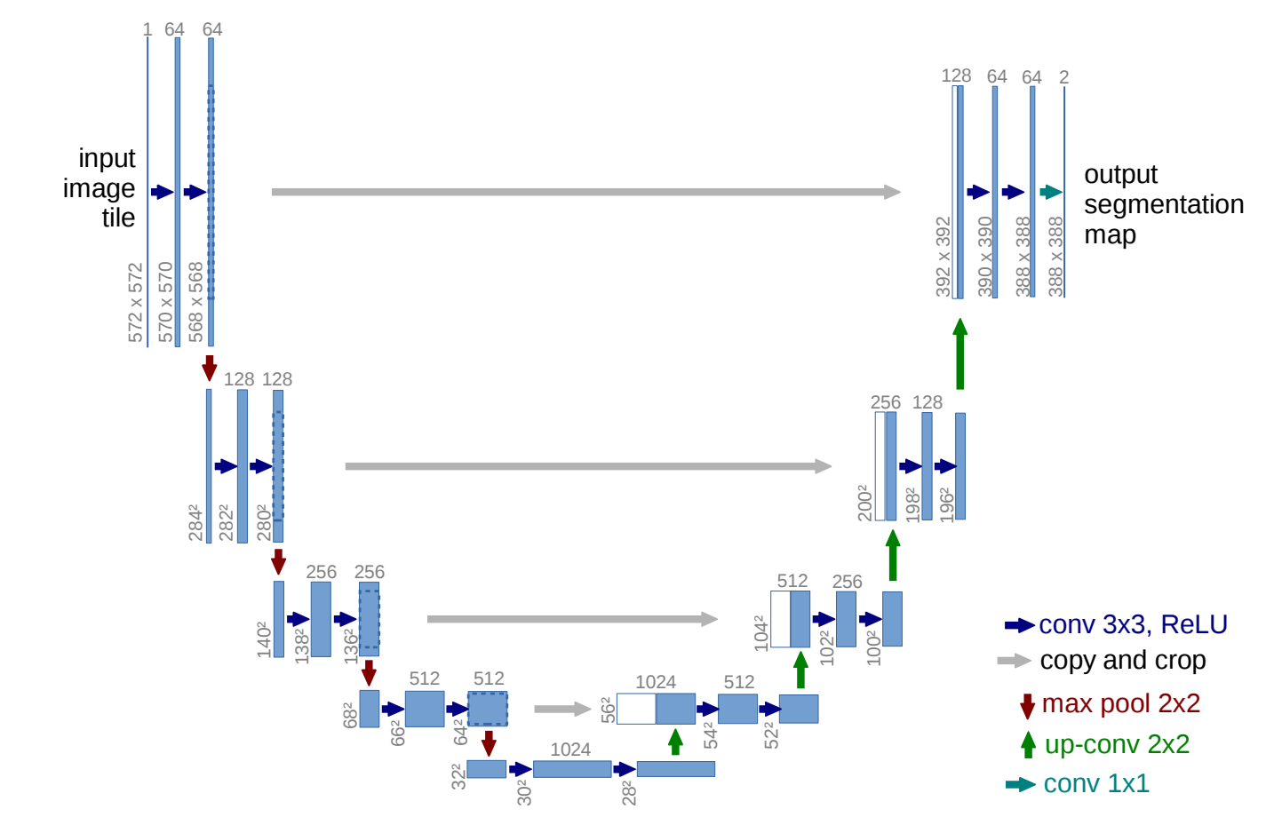

Slide 9
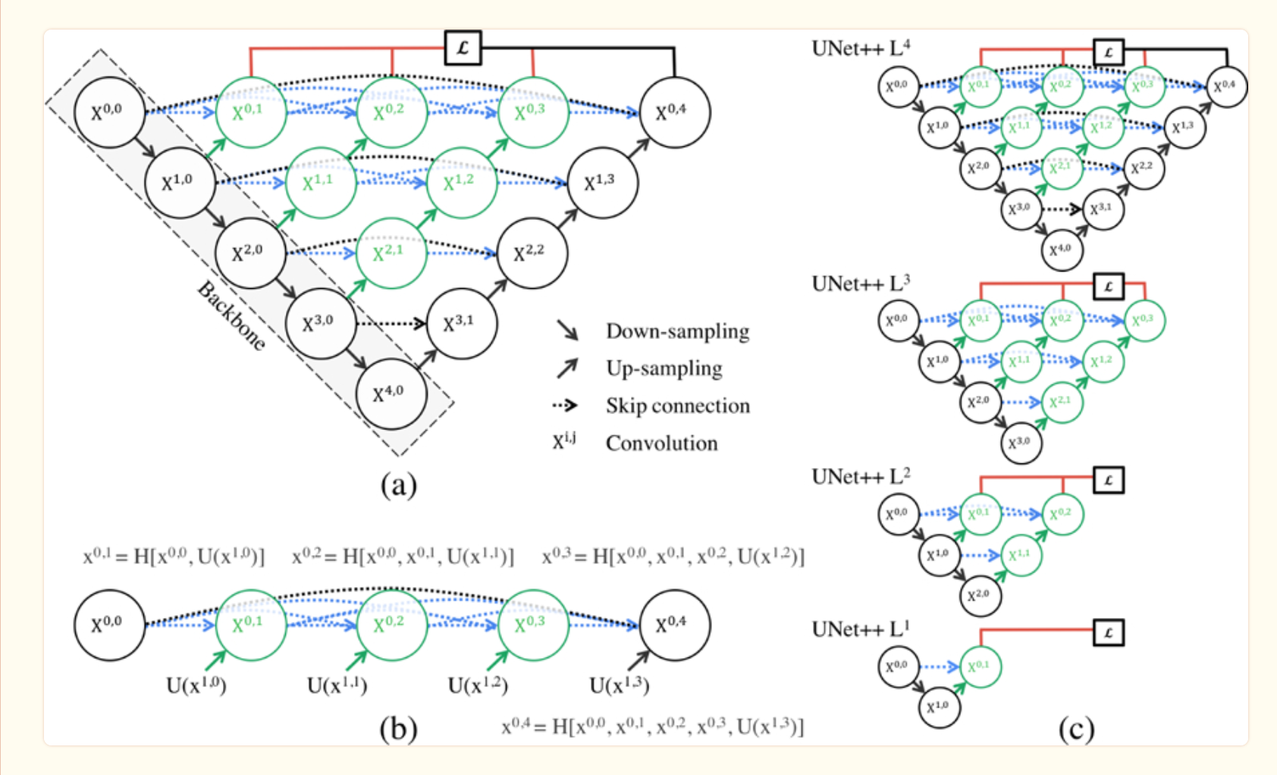
Unet ++

Slide 10
Unet ++
Encoder and decoder are connected through a series of nested dense convolutional block
Idea is that the dense convolution block brings the semantic level of the encoder feature maps closer to that of the feature maps awaiting in the decoder.

Slide 11
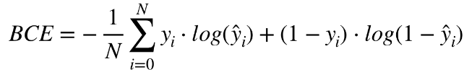
Training
Epochs = 15
Batch Size = 3
Modulated Learning Rate
Loss Function = BCELoss -
AdamW Optimizer

Slide 12

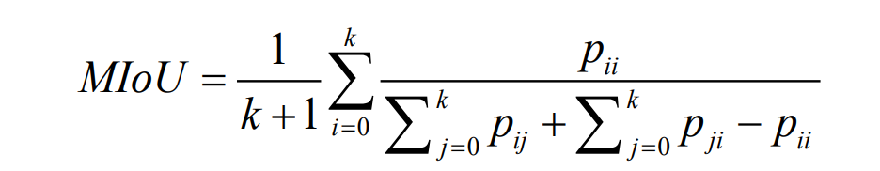
Evaluation metrics
Improve Metrics
Frames Per Second (FPS) - Start/Stop Time during inference, measure time it took to process a given image
Mean Intersection over Union (MIoU) - How well predicted region overlaps with ground truth
k = # classes
p_{ij} = # pixels in class i, but predicted class j
p_{ii} = # pixels in class i, correctly predicted class i
p_{ji} = # pixels in class j, but predicted class i

Slide 13
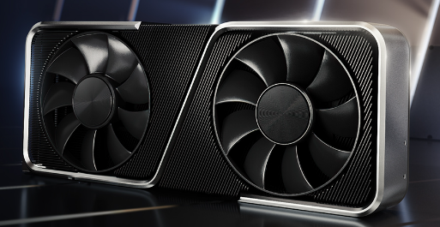
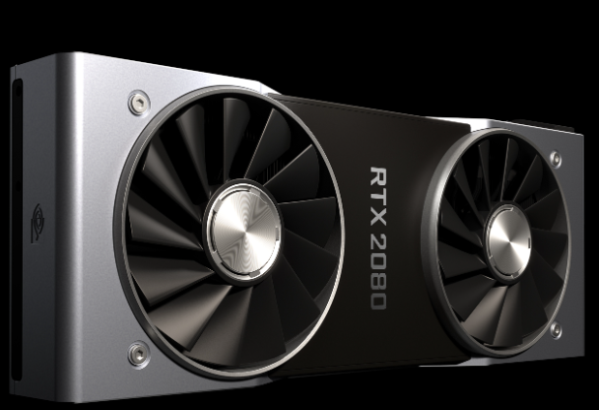
GPU Comparison - Overclocked Benchmarks
RTX 3060
RTX 2080
Lighting - Complex lighting effect rendering - 142 FPS
Reflection - High Dynamic Range Lighting - 151 FPS
MRender - 147 FPS
Gravity - Particle Interaction - 108 FPS
Lighting - Complex lighting effect rendering - 185 FPS, +30%
Reflection - High Dynamic Range Lighting - 229 FPS, +52%
MRender - 193 FPS, +31%
Gravity - Particle Interaction - 158 FPS, +46%
https://gpu.userbenchmark.com/Compare/Nvidia-RTX-3060-vs-Nvidia-RTX-2080/4105vs4026

Slide 14
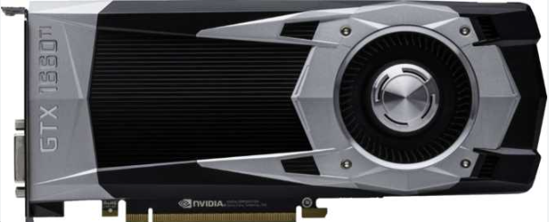
GPU Comparison - Overclocked Benchmarks
GTX 1660 TI
RTX 2080
Lighting - Complex lighting effect rendering - 104 FPS
Reflection - High Dynamic Range Lighting - 134 FPS
MRender - 103 FPS
Gravity - Particle Interaction - 93.8 FPS
Lighting - Complex lighting effect rendering - 185 FPS, +78%
Reflection - High Dynamic Range Lighting - 229 FPS, +71%
MRender - 193 FPS, +87%
Gravity - Particle Interaction - 158 FPS, +68%
https://gpu.userbenchmark.com/Compare/Nvidia-GTX-1660-Ti-vs-Nvidia-RTX-2080/4037vs4026

Slide 15
Results
GPU | Model | Backbone | mIoU | FPS
RTX 3060 (ours) | U-Net (our implementation) | mobilenet_v2 | 80.1 | 225
GTX 1660 TI (ours) | U-Net (our implementation) | mobilenet_v2 | 80.2 | 146.62
RTX 3060 (ours) | Unet++ | mobilenet_v2 | 81.16 | 181
RTX 2080 TI (Paper) | Xception-DeepLabv3+ | mobilenet | 86.49 | 62
RTX 2080 TI (Paper) | DeepLabv3+ with no ASPP | mobilenet | 86.98 | 59

Slide 16
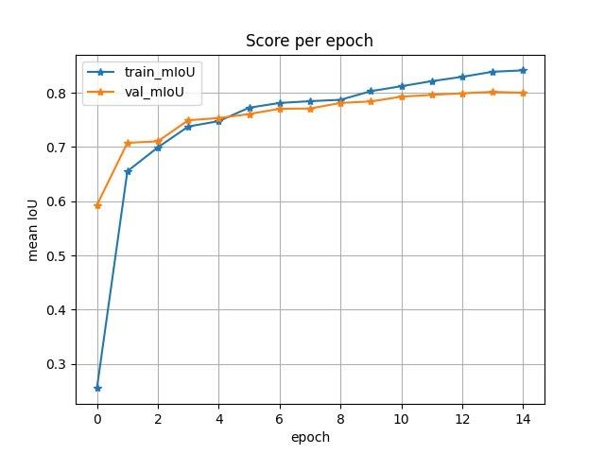
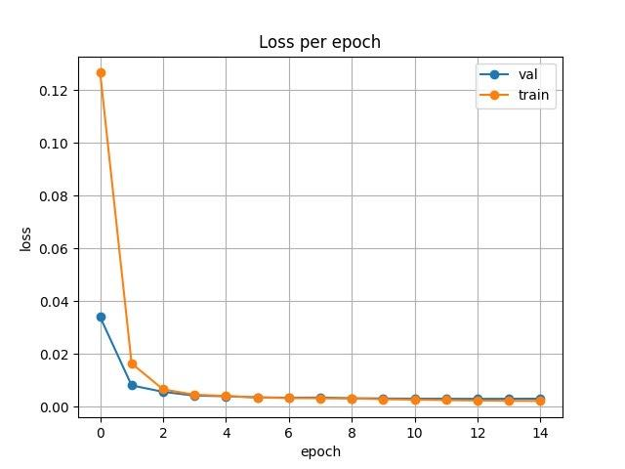
Results - Unet

Slide 17
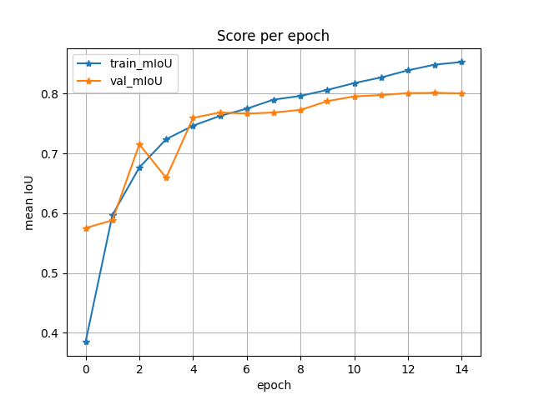
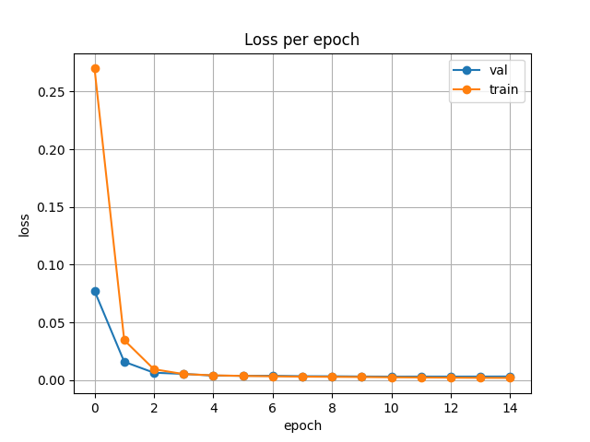
Results - Unet++

Slide 18

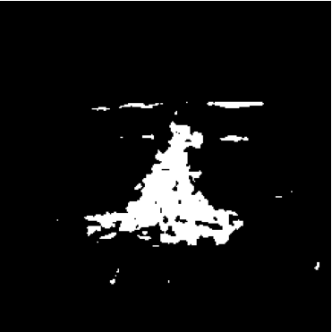
Result on Unseen Data

Slide 19
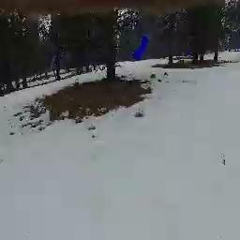
Video Demonstration

Slide 20
References
Mengna Li, Youmin Zhang, Lingxia Mu, Jing Xin, Ziquan Yu, Shangbin Jiao, Han Liu, Guo Xie, Yi Yingmin, A Real-time Fire Segmentation Method Based on A Deep Learning Approach, IFAC-PapersOnLine, Volume 55, Issue 6, 2022, Pages 145-150, ISSN 2405-8963, https://doi.org/10.1016/j.ifacol.2022.07.120. (https://www.sciencedirect.com/science/article/pii/S2405896322005055)
https://paperswithcode.com/sota/real-time-semantic-segmentation-on-cityscapes
Peng, J., Liu, Y., Tang, S., Hao, Y., Chu, L., Chen, G., Wu, Z., Chen, Z., Yu, Z., Du, Y. and Dang, Q., 2022. Pp-liteseg: A superior real-time semantic segmentation model. arXiv preprint arXiv:2204.02681.
Fan, M., Lai, S., Huang, J., Wei, X., Chai, Z., Luo, J. and Wei, X., 2021. Rethinking bisenet for real-time semantic segmentation. In Proceedings of the IEEE/CVF conference on computer vision and pattern recognition (pp. 9716-9725).
https://paperswithcode.com/lib/detectron2/deeplabv3-1#

Slide 21
Thank you!

